Slide 1
Sickle Cell Center for Adults (SCCA)
An overview of Sickle Cell Disease (SCD) from a Medical and Social Service Perspective
By: Robert Plummer

Slide 2
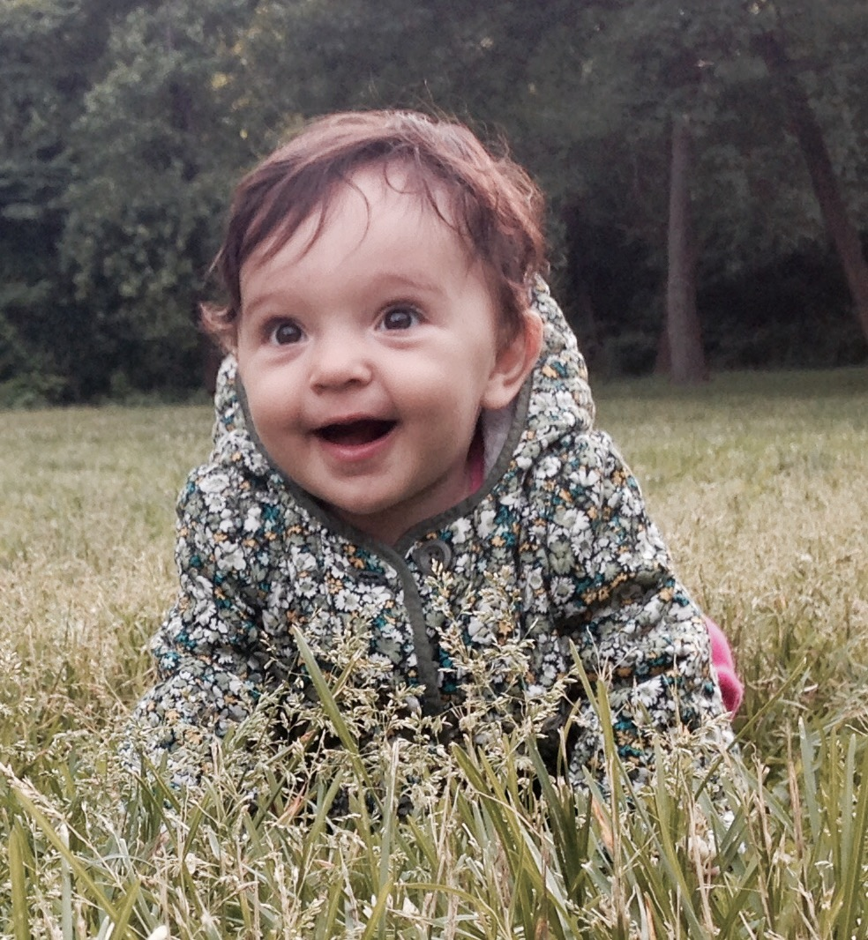
Mini Bio
LMSW working exclusively with Sickle Cell patients for the past 2 ½ years.
Past social work experience in political social work, mentoring programs, and substance abuse counseling.
Reside in Manhattan with my daughter, husband and dog.
Notes:
Where are you all from and why are you here.

Slide 3
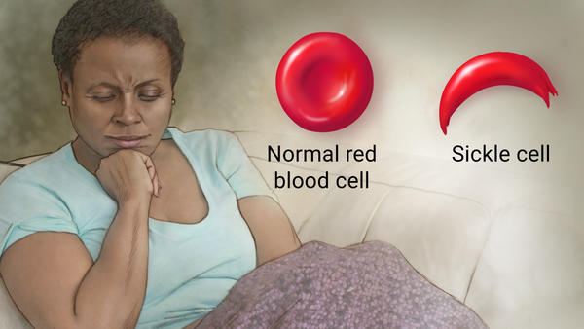
WHAT ?
What is Sickle Cell Disease (SCD)?
Notes:
Ask Audience

Slide 4
What is Sickle Cell Disease?
A group of inherited red blood cell disorders
People with SCD have abnormal hemoglobin, called hemoglobin S or sickle hemoglobin, in their red blood cells.
Adapted from: http://www.nhlbi.nih.gov/health/health-topics/topics/sca/

Slide 5
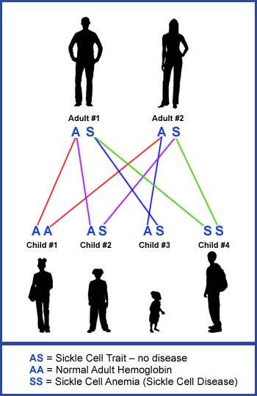
How does one get SCD?
The baby inherits the abnormal hemoglobin from their parents
If one inherits only one sickle gene, you have sickle cell trait. If you inherit two sickle cell genes you have sickle cell disease
You can not catch it

Slide 6
What is Sickle Cell Disease?
Red blood cells that contain normal hemoglobin are flexible and disc shaped. They can move through blood vessels to deliver oxygen.
Sickle hemoglobin is stiff the red cells become crescent or sickle shaped.
Sickle-shaped cells are not flexible and can stick to vessel walls, causing a blockage that slows or stops the flow of blood. When this happens, oxygen can’t reach nearby tissues.
Adapted from: http://www.nhlbi.nih.gov/health/health-topics/topics/sca/

Slide 7
Sickle Cell Disease Symptoms
Lack of tissue oxygen can cause attacks of sudden, severe pain, called pain crises. These pain attacks can occur without warning, and a person often needs to go to the hospital for effective treatment.
Most children with SCD are pain free between painful crises, but adolescents and adults may also suffer with chronic ongoing pain.
The red cell sickling and poor oxygen delivery can also cause organ damage.

Slide 8
Manifestation of Sickle Cell Disease
PAIN

Slide 9
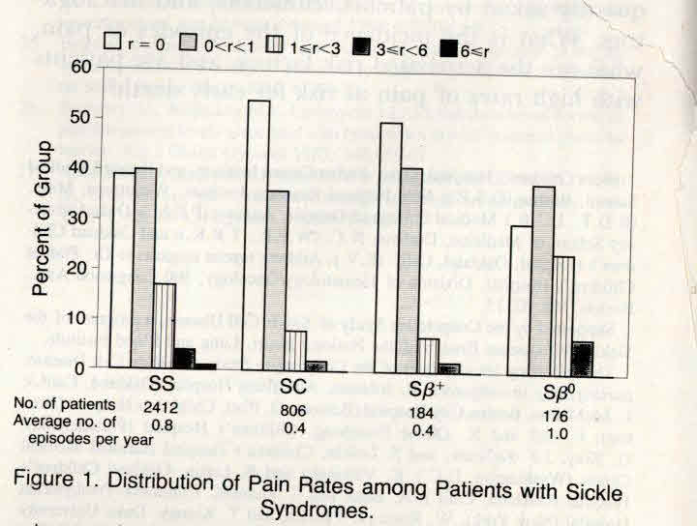
Variability of pain rates in SCD
39%: no episodes of severe pain; 1% had >6 episodes per year;
5% of SCD individuals accounted for >30% of episodes
r denotes the number of episodes of pain per patient-year, SS sickle cell anemia, SC hemoglobin SC disease, Sβ+ sickleβ+-thalassemia, and Sβ0 sickle β0-thalassemia.
Platt et al NEJM 1991

Slide 10
Triggers for Pain Crisis
Extreme temperatures
Dehydration
Stress

Slide 11
Acute & Chronic Pain in Sickle Cell Disease
Chronic pain in adults with sickle cell disease includes biological, psychological, sociological, and spiritual factors.
Depression and anxiety are common in those with SCD. Levenson (2008)
There is a strong relationship between depression and chronic pain.
SCD patients are undertreated for depression and the psychological impact of their chronic illness.

Slide 12
Stigma of SCD Pain
There is a stigma associated with SCD patients who use opiate medications for their pain. They are often treated as “drug seekers” in the ER and on inpatient units.
Patients are predominately minorities
Pain is subjective. There is no medical test for pain.
Patients are often on high does and quantities of opiate medications

Slide 13
U.S. Life Expectancy: Sickle Cell Disease
Hydroxyurea
50
Preventive
Penicillin
40
National Sickle Cell Act
30
Life Expectancy (Years)
20
Transfusion for Stroke Prevention
10
0
1900
1910
1920
1930
1940
1950
1960
1970
1980
1990
2000
Year
Notes:
Survival has increased dramatically in sickle cell disease in the US since its first description by James Herrick in 1910. Early death is still the rule in resource-poor environments. The first major improvement in survival came with the recognition that septicemia was a major cause of death in young children with sickle cell disease, often before they had been diagnosed, since characteristic clinical symptoms are often not evident until the second year of life. Early, aggressive treatment with antibiotics, and use of blood transfusions for acute chest syndrome, greatly improved survival of sickle cell patients into adulthood. Major morbidity remains, however, especially from stroke and pain.
Once they reach adulthood, patients with sickle cell disease suffer from chronic organ damage due to repeated sickling and vascular damage. Death is usually do to chronic organ failure: lung, kidneys, and cardiac failure are the primary causes. Recent work has shown that chronic vascular damage is due both to adherent erythrocytes and hemolysis. Intravascular hemolysis interferes with the NO vasodilating system in two ways: (1) releases rbc arginase into the plasma, lowering the synthesis of NO; (2) increases plasma free Hb, which directly scavanges endothelial-derived NO.

Slide 15
Research is needed to develop new therapies
Not much change in 50 +years
Current therapies
IV fluids and narcotics
Transfusions
Oxygen supplementation
Hydroxyurea
Many Barriers to development of new therapies
Rare illness
Lack of unified patient’s advocacy
Poor enrollment, many trials closed for lack of accrual

Slide 16
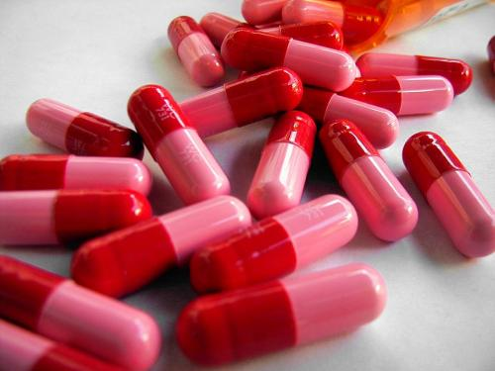
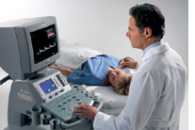
What has worked?
Neonatal screening.
Penicillin prophylaxis.
Stroke risk screening.
Hydroxyurea use.
5. Coordination of care.
For the future?
Stem cell transplant and gene therapy.

Slide 17
WHO ?
Who is Sickle Cell Disease?
Notes:
Audience cards

Slide 18
Who is Sickle Cell Disease?
Sickle cell disease (SCD) affects millions of people throughout the world and is particularly common among those whose ancestors came from sub-Saharan Africa; Spanish-speaking regions in the Western Hemisphere (South America, the Caribbean, and Central America); Saudi Arabia; India; and Mediterranean countries such as Turkey, Greece, and Italy.
The exact number of people living with SCD in the U.S. is unknown.
It is estimated that:
SCD affects approximately 100,000 Americans.
SCD occurs among about 1 out of every 365 Black or African-American births.
SCD occurs among about 1 out of every 16,300 Hispanic-American births.
About 1 in 13 Black or African-American babies is born with sickle cell trait (SCT).
Adapted from CDC SCD Homepage: http://www.cdc.gov/ncbddd/sicklecell/data.html

Slide 19
Population of the Bronx
According to the 2012 American Community Survey of the U.S. Census, the Bronx is the nation’s poorest urban county; the poverty rate is 31% (compared to 19.4% city-wide) and median income $32,450 (compared to $51,270 city-wide).
There are 44.5% of Bronx children living below poverty, also one of the highest child poverty rates in the United States. There are 7.37% of Bronx households on public assistance, twice the percentages in New York City (4.15%) and New York State (3.40%). There are 84.18% of Bronx students eligible for reduced-fee and free lunch programs.
The Bronx unemployment rate of 11.9% is one of the highest unemployment rates in the country. Despite the high poverty and unemployment rates, 27% of Bronx residents ages 25 and older have received their high school diploma or GED, higher than citywide (24%) and statewide (26.9%) attainment rates.
The Bronx is ethnically diverse. Its population is 54.3% Hispanic, 33.2% African-American, 10.6% White, 3.7% Asian, and 3.3% Other. Almost one-third (34.7%) of its residents are foreign-born and 40.7% of the births are to foreign-born mothers. Among these immigrants, more people speak a foreign language at home (predominantly Spanish) than speak “only English.”
Its new immigrants come from diverse corners of the globe (in order of their numbers): Dominican Republic, Jamaica, Mexico, Ecuador, Guyana, Ghana, Honduras, Italy, Trinidad & Tobago, and Bangladesh. The Bronx was New York City’s first borough to have a majority of people of color and is the only borough with a Latino majority.
Adapted from: Montefiore Medical Center Community Service Plan 2014-2017: http://www.montefiore.org/documents/communityservices/Montefiore-2014-2017-Community-Services-Plan.pdf

Slide 20
Psychosocial Factors in SCD
Burden of illness on their family
Abnormal habitus
Limitations on social life
Inefficiency at work or inability to work and attend school
Depressive feelings or thinking about illness
Irritability
Suicidal ideation
Loss of useful opportunities
Difficulty making friends
Feelings of loneliness

Slide 21
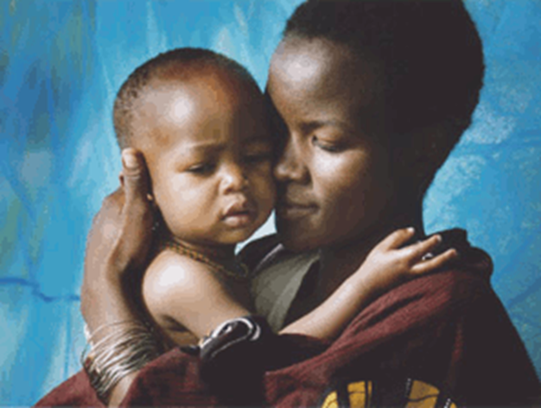
SCCA Mission statement
To provide exceptional, seamless, comprehensive, compassionate and individualized care, education, counseling, and research for people living with sickle cell disease

Slide 22
Sickle Cell Social Worker Role
Emotional Support
Support Group
Individual Counseling
Inpatient/ED Psychosocial Support
Benefits/Services
Insurance
Transportation
Home Care
Coordination of Care
Navigation of Health Care System

Slide 23
The SCCA is the core of all the professionals that are dedicated to the care of people with sickle cell disease in the Bronx
SCCA
Specialty care
ED
INPT
Primary care

Slide 24
How big is the Sickle Cell Center at Montefiore?
~6,000 visits/year
Outpatient : ~ 300 patients
Inpatient care: ~ 1,000 patients had ~1,500 hospitalizations
Emergency
Room

Slide 25
Mission: To Deliver Exceptional, Comprehensive, Compassionate, Individualized care
Increase PREVENTIVE care
Outpatient specialty care: Hematology
Outpatient primary care: Family medicine
Decrease episodic, emergency room care
Decrease hospitalizations
Increase quality of care
Increase patient’s engagement
Increase community engagement
Increase physicians/nurses/health care professional’s knowledge about SCD
Increase patients self efficacy

Slide 26
How can we do better?
By preventing end organ damage BEFORE it occurs through comprehensive outpatient care
By raising awareness of and funding for Sickle Cell Disease

Slide 27
Sickle Cell Disease Awareness
Approximately 10% of all sickle cell patients in the United States of America live in New York State
Due to the disease complications and the poor care adult patients receive, many are unable to work and must rely on public assistance and public medical care to survive.
At $15,000 per patient, sickle cell disease patients are the costliest patients for NYS Medicaid services.
To date, NYS spends only about $250,000 for improvements in sickle cell disease care – far below the $2 million Pennsylvania spends or the $4 million North Carolina devotes to SCD care.
Notes:
Hand out letters

Slide 28
SCD model for health care delivery: what have we learned?
Education Education Education
Access to care
Continuity of care
Coordination of care
Uniformity of care
Comprehensive care

Slide 29
Family and
patient
education
Multi
-
Health
disciplinary
maintenance
/
team of
prevention
professionals
Medical
Home
Genetic
Access to
counseling
appropriate
and education
medical care for
acute illness
Psychological
and social
services
Medical Home Model of Care

Slide 30
It takes a village
Many individuals are involved in today’s complex health care system
We are excited to coordinate care with providers in the community dedicated to assisting our patients with complex social service needs
All members of the care team are equal and essential to the functioning of the whole
Patients are the “main square” of the village we must engage them in their care

Slide 31
How are we going to achieve all of this?

Slide 32
Questions?

